Slide 1
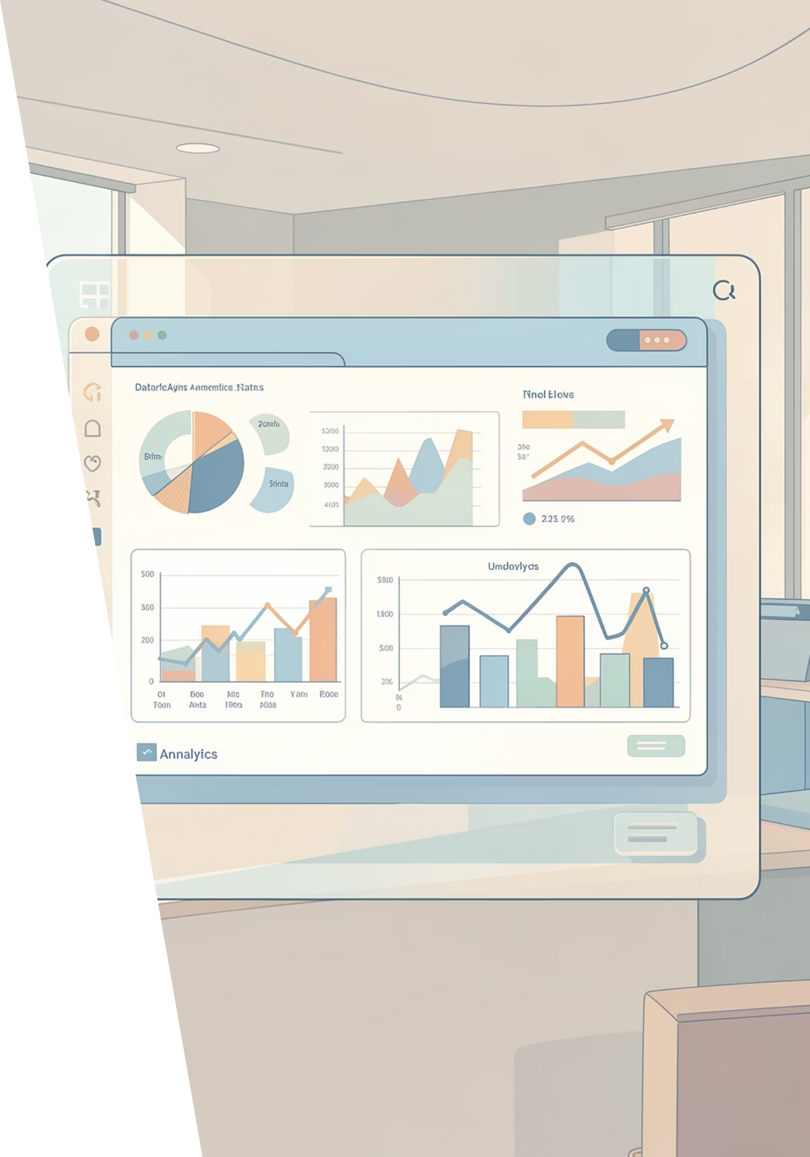
Customer Shopping Behavior Analysis
Uncovering insights from 3,900 purchases to guide strategic decisions

Slide 2
PROJECT SCOPE
Dataset Overview
3.9K
18
50
Total Purchases
Data Features
Locations
Key Data Points
Customer demographics & purchase history
Product categories, sizes, colors, seasons
Discounts, subscriptions, shipping preferences
Review ratings & payment methods

Slide 3
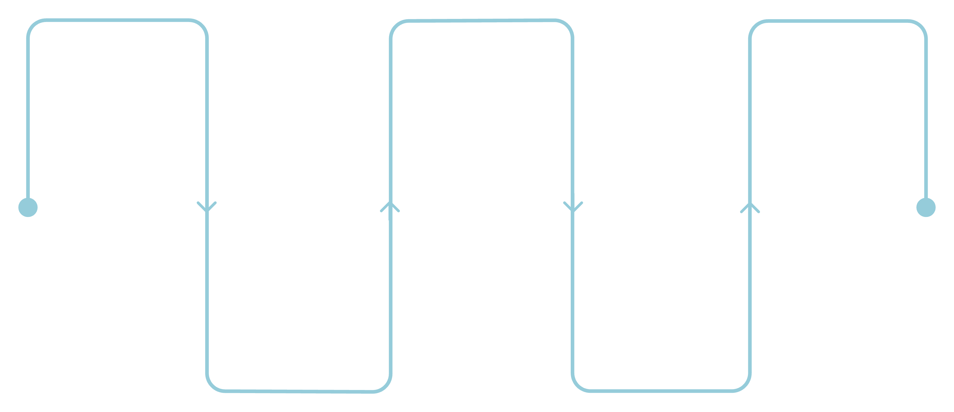
DATA PREPARATION
Python Analysis Pipeline
Load Data
Handle Missing Values
Export to PostgreSQL
Import raw datasets
Impute or remove gaps
Save cleaned dataset
Clean & Standardize
Engineer Features
Normalize columns and formats
Create age groups and metrics
Cleaned dataset with imputed review ratings, standardized columns, and new age groups for deeper analysis

Slide 4

Revenue Insights by Gender
Male Customers
Female Customers
$157,890 total revenue
$75,191 total revenue
68% of total sales
32% of total sales

Slide 5
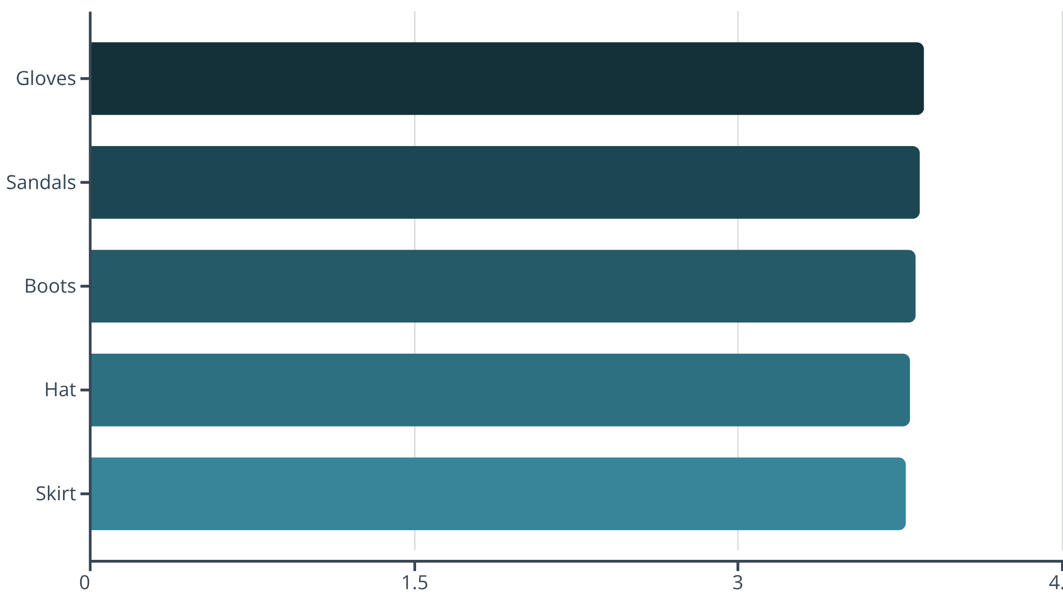
Top Performing Products
Customer Favorites
Accessories and footwear lead in customer satisfaction
Average rating across all products: 3.75 stars
839 customers used discounts while spending above average

Slide 6

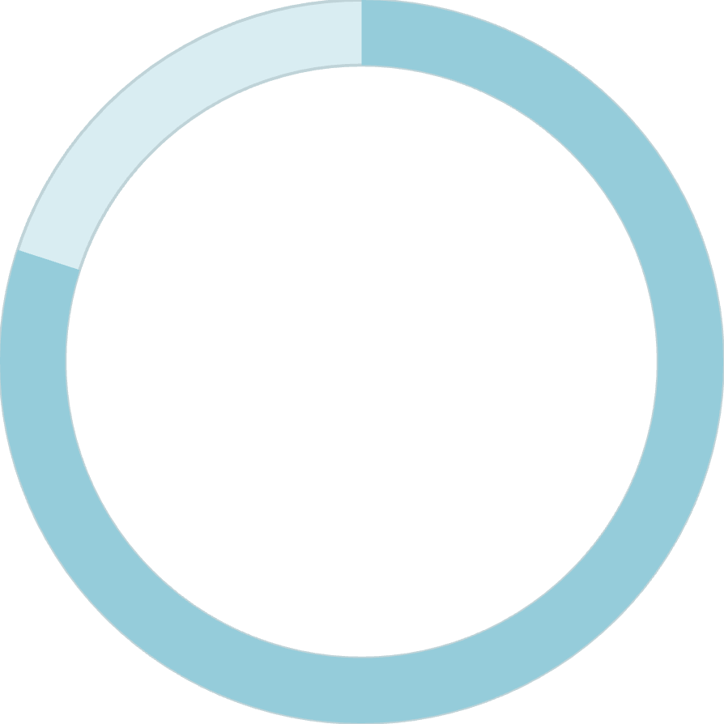
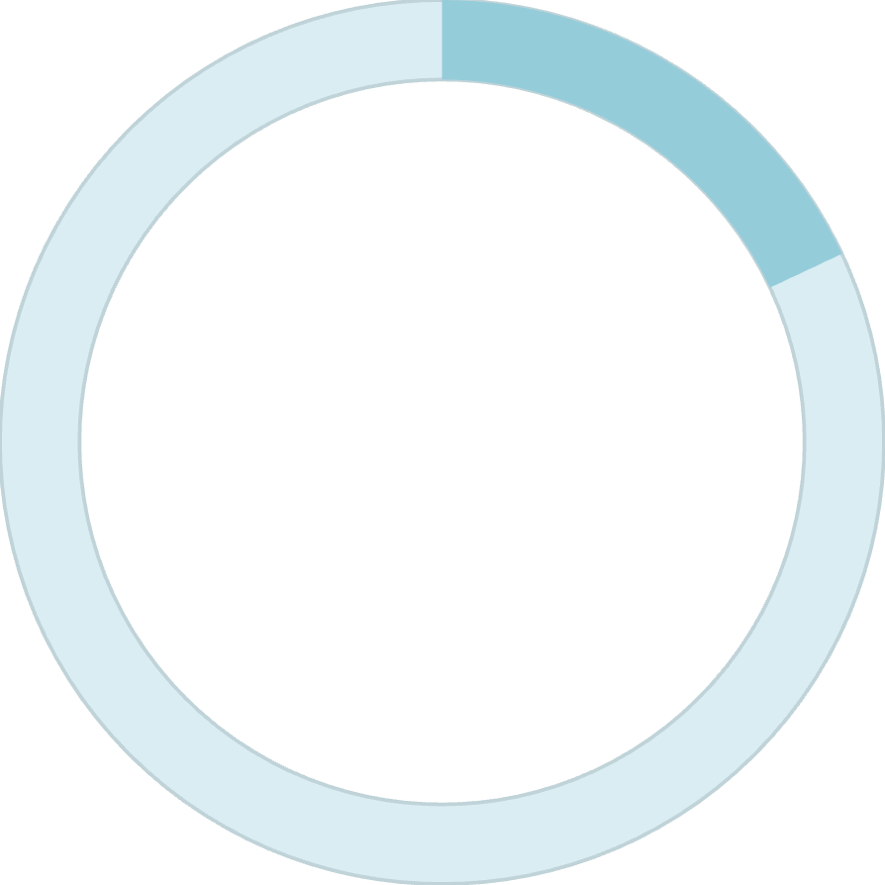

CUSTOMER SEGMENTS
Loyalty Distribution
80%
18%
2%
Loyal Customers
Returning
New
3,116 repeat buyers
701 customers
83 first-time buyers

Slide 7
Subscription vs Non-Subscription
Key Finding
Opportunity
Only 27% of customers subscribe
Minimal spending difference between groups
Subscribers spend $59.49 on average
958 repeat buyers with subscriptions vs 2,518 without
Non-subscribers spend $59.87 on average
Huge potential to convert loyal non-subscribers

Slide 8
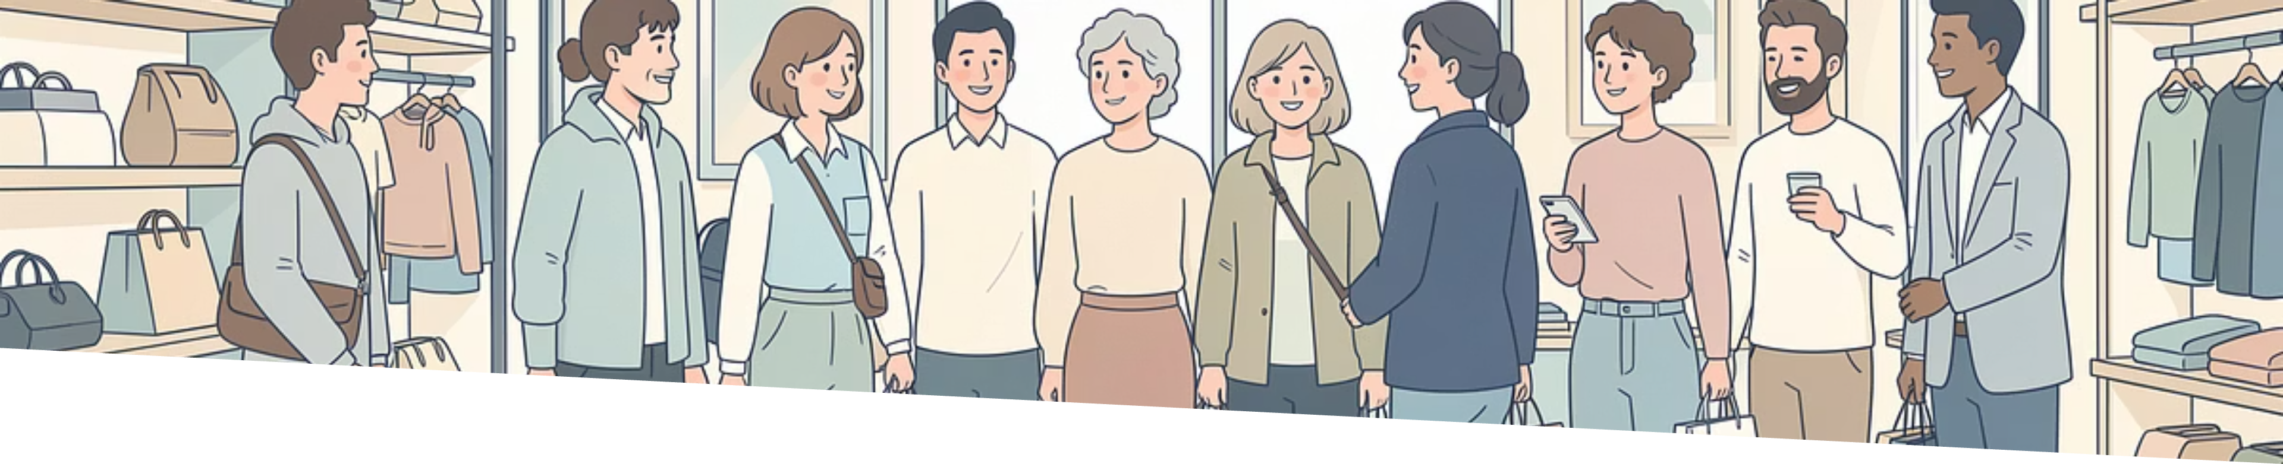
Revenue by Age Group
Young Adult
Middle-aged
Adult
Senior
$62,143 revenue
$59,197 revenue
$55,978 revenue
$55,763 revenue
Highest contributor
Strong segment
Steady performance
Consistent buyers

Slide 9
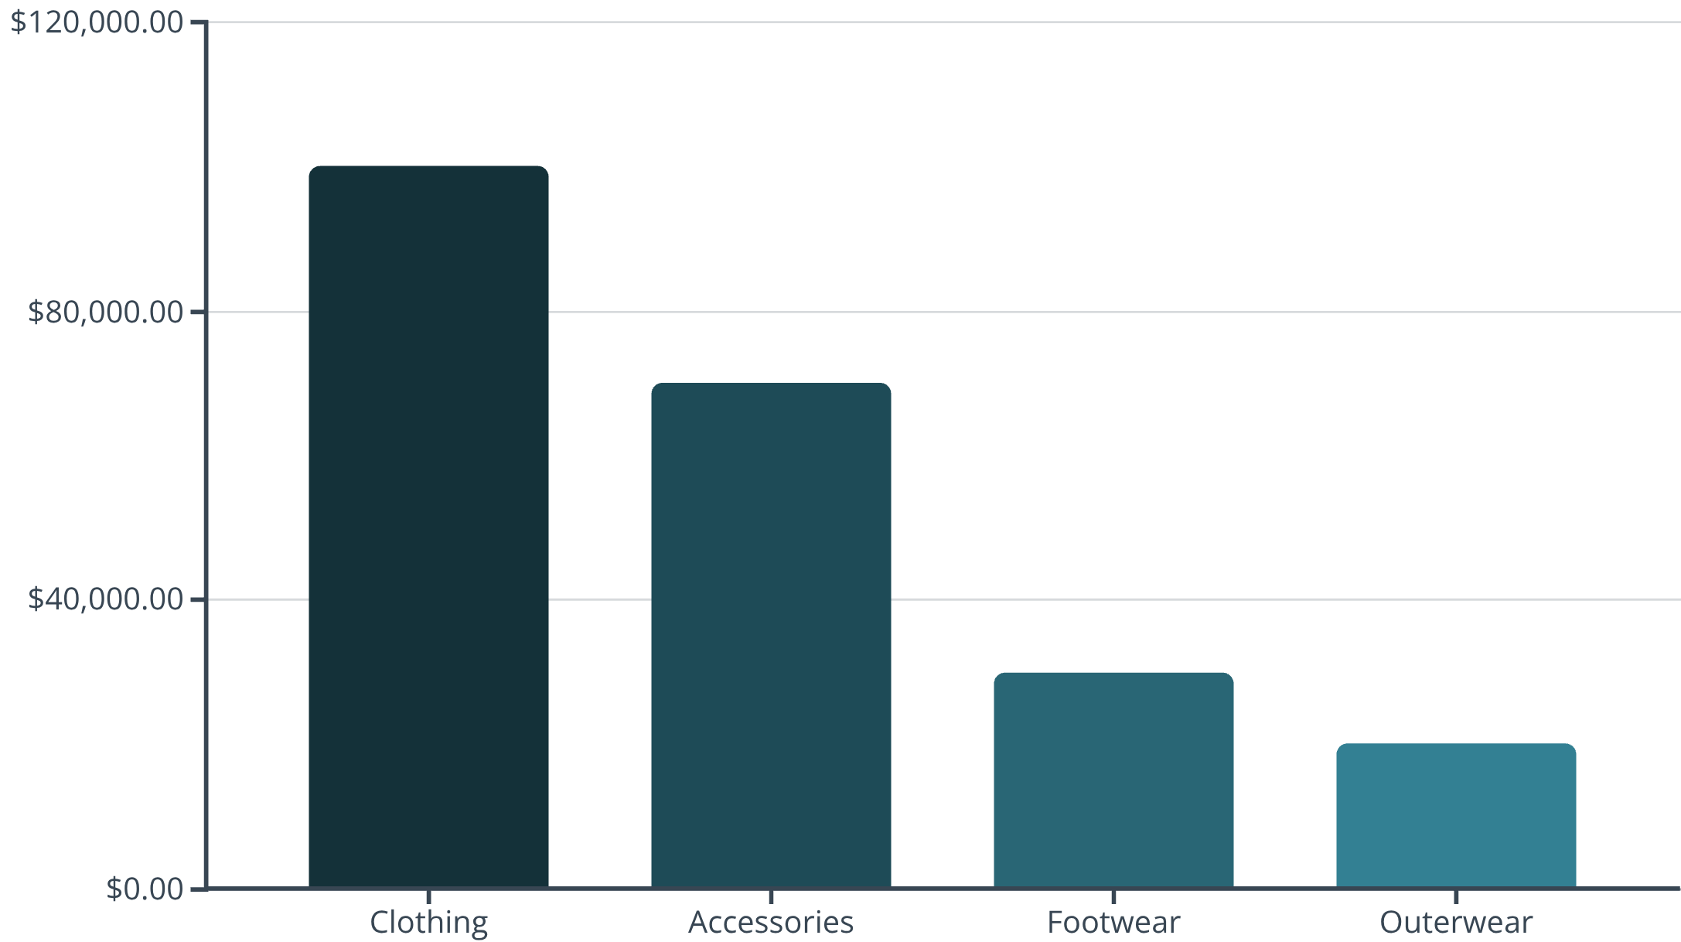
CATEGORY PERFORMANCE
Sales & Revenue Leaders
Category Insights
Clothing dominates with 1,737 purchases
Top items: Blouse, Pants, Shirt
Hat shows highest discount dependency at 50%

Slide 10

Strategic Recommendations
01
02
Boost Subscriptions
Loyalty Programs
Promote exclusive benefits to convert 73% non-subscribers
Reward repeat buyers to strengthen 80% loyal segment
03
04
Optimize Discounts
Targeted Marketing
Balance sales boosts with margin control on high-discount items
Focus on young adults and express shipping users

